Slide 1


VOTING SYSTEM
BY :
BARATHRAJ.N(RA2111013010009)
RAGHAPRIYA.T(RA2111013010011)

Slide 2
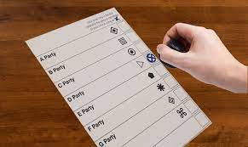
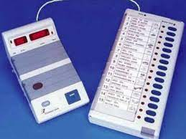

INTRODUCTION
In early days the voting was done by ballot system after that we have changed to electronic system of voting. Now it is the only way people are casting their vote. So we have created the basic level of electronic system of voting in that we used our C program by which we can easily check the count of voting by the candidate.

Slide 3

ABSTRACT OF THE PROJECT
Step 1 : In this project, we program a system to cast vote to the candidate of our interest and to find the votes count.
Step 2 : First, the variables are declared and initialized.
Step 3 : Then its programmed for reading our input, either to cast the vote or to find the vote count.
Step 4 : After the votes are casted.
Step 5 : The total votes count can be counted.
Step 6 : Finally, the winner can be declared as the output comes.

Slide 4
FEATURE OF THE PROJECT
In most of the voting machines, we can only cast the vote and then the votes are manually counted and the winner is declared.
But here, the total votes count will also be calculated and then winner is declared.
Usually, in voting machines, once we casted the vote the total vote count of a person registered for that particular region will be counted manually and then it will be added with the total votes he has got in the other regions. But here no manual work is needed.
It takes just 1 or 2 seconds to cast the vote while many other machines takes more than that.

Slide 5
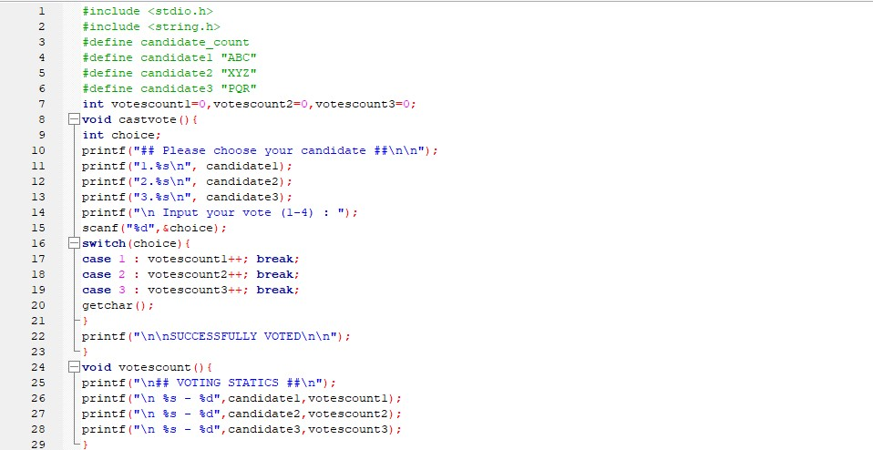
CODING

Slide 6
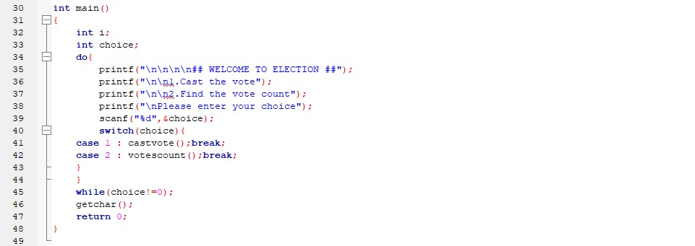

Slide 7
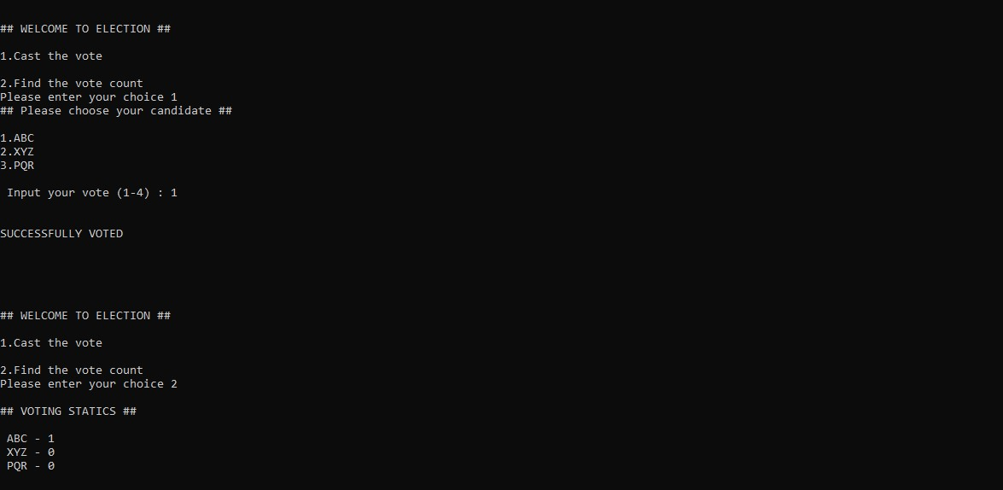
OUTPUT

Slide 8

THANK YOU !

